Slide 1

Title sap rEview

Slide 2
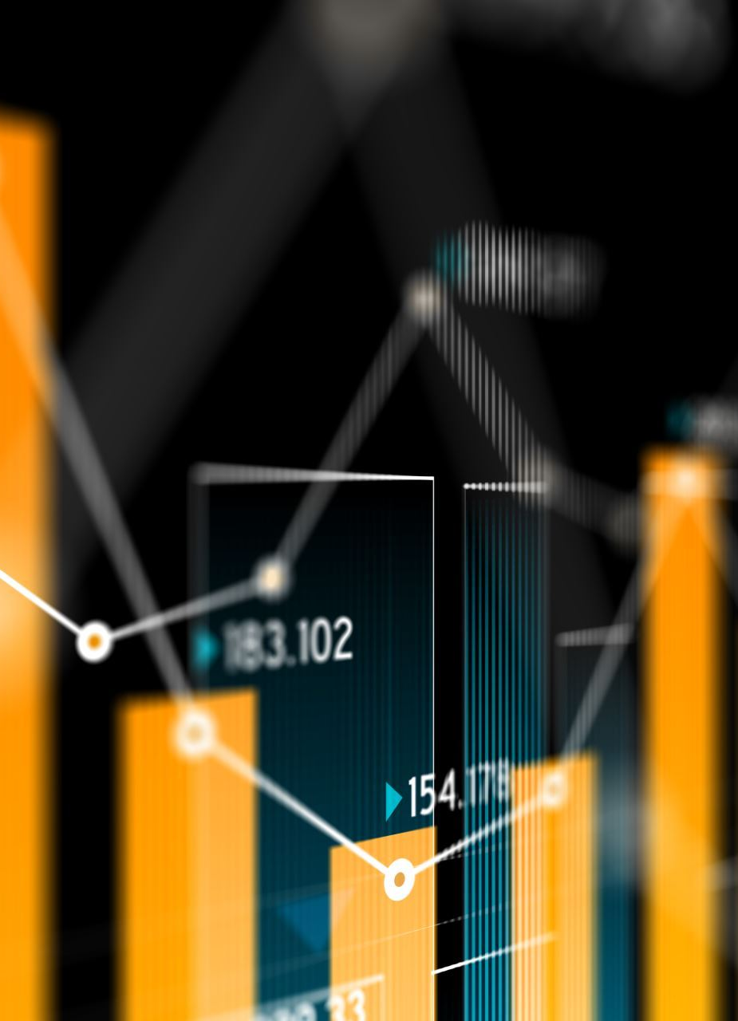
SAP-Review
Title: "Sentiment Analysis of Product Reviews: Unveiling Customer Insights"

Slide 3

Introduction
This project is a vital exploration into the world of consumer feedback
This project is your gateway to understanding the voices of consumers in the digital age and leveraging their sentiments for informed, data-driven actions

Slide 4

Objectives
Our main objectives are to analyze the sentiment of product reviews and gain insights into customer feedback

Slide 5

Significance of Sentiment Analysis
Customer Insights: Sentiment analysis allows businesses to gain a deeper understanding of their customers.
Brand Management: Monitoring sentiment helps companies manage their brand's reputation.

Slide 6

Data Collection
Our data collection process is robust and diverse, involving web scraping, preprocessing, and metadata extraction.
We prioritize ethical practices and use random and stratified sampling to ensure balanced representation.

Slide 7

Sentiment Analysis Methodology
Sentiment Analysis Methodology: TextBlob, a natural language processing library, was used for sentiment analysis

Slide 8
Sentiment Analysis in Action
Sentiment Analysis in Action: Let's see how sentiment analysis works with some example product reviews
Review 1: "This product is amazing! I love it."
Review 2: "Terrible product. Waste of money."
Review 3: "The product is okay."

Slide 9

Sentiment Analysis Results
Sentiment Analysis Results: After analyzing a substantial number of reviews, we found the following distribution
Positive: 60%
Neutral: 25%
Negative: 15%

Slide 10

Tools Required
Text Processing Libraries: Libraries like NLTK (Natural Language Toolkit), spaCy, or the Stanford NLP library can help with text preprocessing tasks such as tokenization, stop word removal, and stemming/lemmatization.
Machine Learning Libraries: Python libraries like scikit-learn, TensorFlow, and Keras are commonly used for building sentiment analysis models. You may also consider pre-trained models like BERT or GPT-3 for more advanced analyses.

Slide 11

Real-World Applications
Real-World Applications: Sentiment analysis has practical applications across various industries, including e-commerce, hospitality, and healthcare

Slide 12

Future Work
Future research can explore more advanced sentiment analysis techniques, such as deep learning models

Slide 13

Conclusion
Conclusion: In summary, our project successfully achieved its objectives of sentiment analysis in product reviews

Slide 14
Thank you

